Slide 1
Research Communication Skills
IoT Research Background

Slide 2
Intended Learning Outcomes
By the end of this lesson you will be able to:
  describe a background of IoT research
  find research papers about IoT
  find research papers in your own research area

Slide 3
Outline
IoT Background
IoT Challenges
IoT Research Fields
IoT Journals and Conferences

Slide 4
Intended Learning Outcomes
By the end of this lesson you will be able to:
  describe a background of IoT research
  find research papers about IoT
  find research papers in your own research area

Slide 5

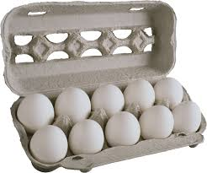
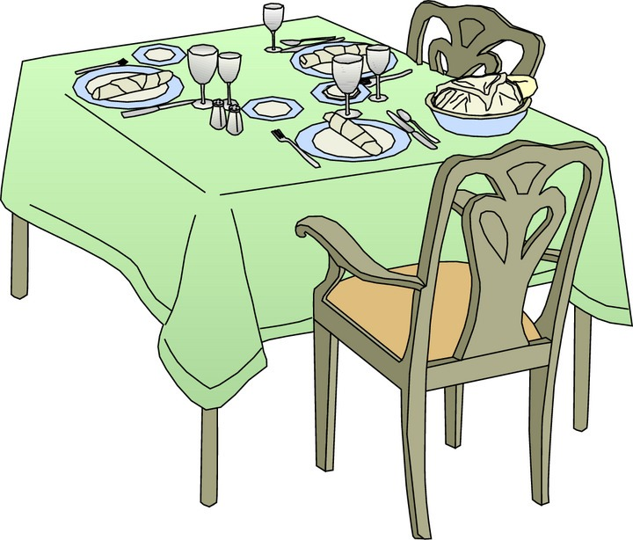
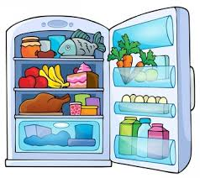


The Internet of Things (IoT) is the network of physical objects—devices, vehicles, buildings and other items embedded with electronics, software, sensors, and network connectivity—that enables these objects to collect and exchange data.

Slide 6
What’s the Internet of Things - History
1997, “The Internet of Things” is the seventh in the series of ITU Internet Reports originally launched in 1997 under the title “Challenges to the Network”.
1999, Auto-ID Center founded in MIT
2003, EPC Global founded in MIT
2005, Four important technologies of the internet of things was proposed in WSIS conference.
2008, First international conference of internet of things: “The IOT 2008” was held at Zurich.

Slide 7
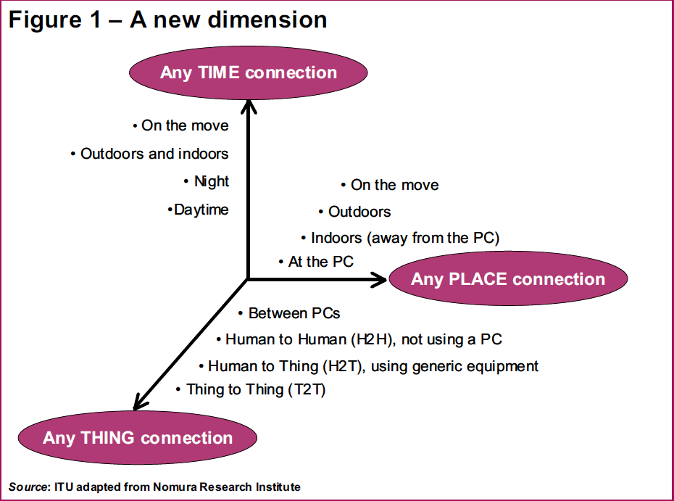
What’s the Internet of Things
From any time, any place connectivity for anyone, we will now have connectivity for anything!

Slide 8
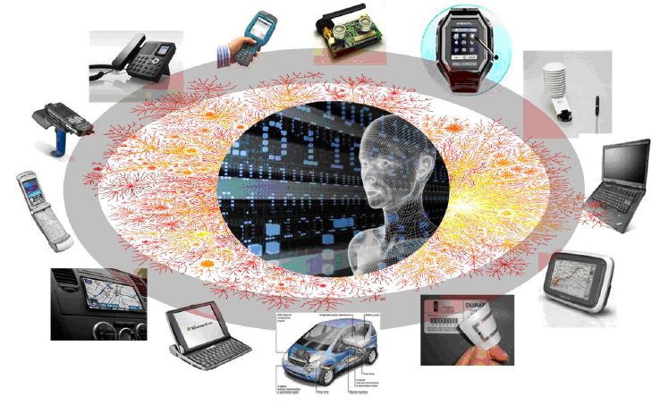
Things Connected: communication between physical world and information world

Slide 9
Layers of IoT Architecture
Application Layer
Network Layer
Perception Layer

Slide 10
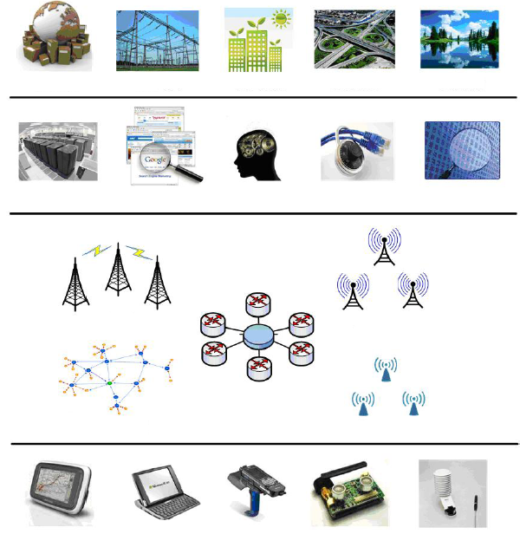
4 Layers Model
Integrated Application
Smart Logistic
Smart Grid
Green Building
Smart Transport
Env. Monitor
Information Processing
Data Center
Search Engine
Smart Decision
Info. Security
Data Mining
Network Construction
WWAN
WMAN
Internet
WPAN
WLAN
Sensing and Identification
GPS
Smart Device
RFID
Sensor
Sensor

Slide 11
Layers of IoT Architecture
3 Layers Model
4 Layers Model
Application Layer
Network Layer
Perception Layer
Integrated Application
Information Processing
Network Construction
Sensing and Identification

Slide 12
7 Layers Model
People and Process Layer
Application
Data Analysis
Data Ingestion
Global Infrastructure
Connectivity/Edge Computing
Things

Slide 13
7 Layers Model
People and Process Layer
This includes people, businesses, collaboration and decision making based on the information derived from IoT computing.
Application
Comprises of the custom applications that is actually making use of the things data.
Data Analysis
Relates to data reporting, mining, machine learning etc.
Data Ingestion
Includes bigdata, cleansing, streaming and storage of data.
Global Infrastructure
Typically is implemented in cloud infrastructure. Most of the IoT solutions integrate with cloud services. A comprehensive set of integrated services, IoT cloud can provide businesses with useful insights and perspective on customers.
Connectivity/Edge Computing
Defines the various communication protocols and networks used for connectivity and edge computing. It is a distributed architecture where IoT data is processed at the edge of the network.
Things
Comprises of devices, sensors and controllers. Connected devices are what enable the IoT environment. These devices include mobile devices such as smart phones or tablets, micro controller units and single-board computers. The connected devices are the real endpoint for IoT.

Slide 14
What’s the Internet of Things - History
1997, “The Internet of Things” is the seventh in the series of ITU Internet Reports originally launched in 1997 under the title “Challenges to the Network”.
1999, Auto-ID Center founded in MIT
2003, EPC Global founded in MIT
2005, Four important technologies of the internet of things was proposed in WSIS conference.
2008, First international conference of internet of things: “The IOT 2008” was held at Zurich.

Slide 15
Enabling Technologies
RFID
Sensor
Smart Tech
Nano Tech
To identify and track the data of things
To collect and process the data to detect the changes in the physical status of things
To enhance the power of the network by devolving processing capabilities to different part of the network.
To make the smaller and smaller things have the ability to connect and interact.

Slide 16
Sensor Technology
The ability to detect changes in the physical status of things is essential for recording changes in the environment.
Wireless sensor technology play a pivotal role in bridging the gap between the physical and virtual worlds, and enabling things to respond to changes in their physical environment. Sensors collect data from their environment, generating information and raising awareness about context.
Example: sensors in an electronic jacket can collect information about changes in external temperature and the parameters of the jacket can be adjusted accordingly

Slide 17



Daily life in IoT Era
Life will be changed completely with the technology of IoT
  The car will generate alarm automatically if the driver has made any mistake during the operation
  The bag will send out reminder message if the owner forgot bring something
  The cloth will tell the washing-machine about its requirement for the water temperature

Slide 18
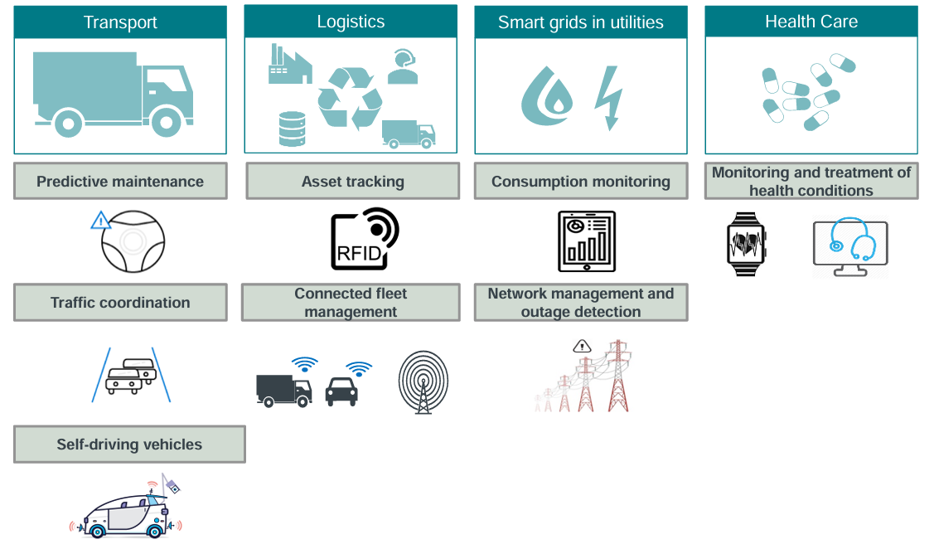
IoT applications

Slide 19
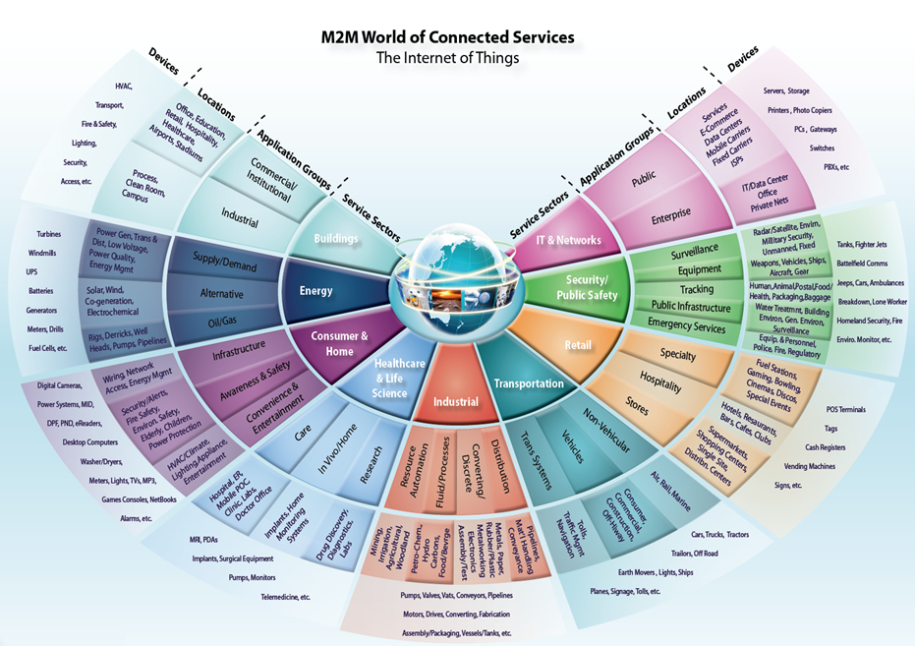
Information Security
Office of Budget and Finance
Education – Partnership – Solutions

Slide 20
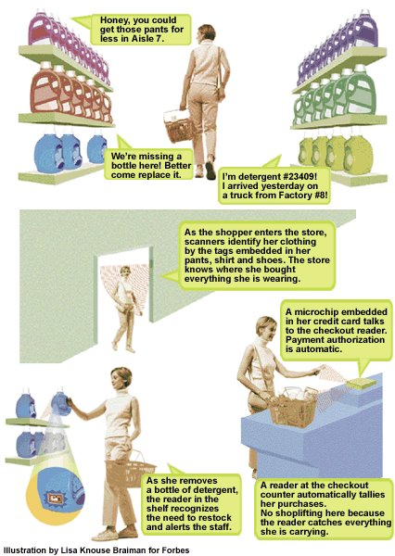
IoT Application Example (1)
Scenario: shopping
(2) When shopping in the market, the goods introduce themselves.
(1) When entering the doors, scanners identify the tags on shopper’s clothing.
(4) When paying for the goods, the microchip of the credit card communicates with checkout reader.
(3) When shoppers remove goods from the shelf, the reader tell the staff to put a new one.

Slide 21
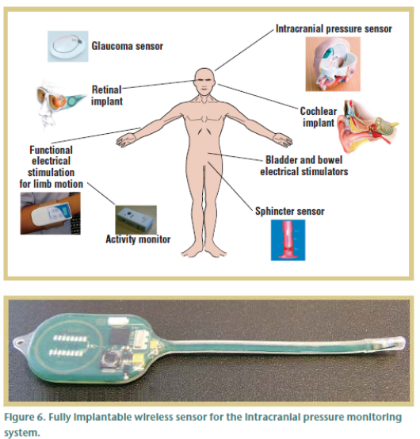
IoT Application Example (2)
Scenario: Health Care
Various sensors for various conditions
Example ICP sensor: Short or long term monitoring of pressure in the brain cavity
Implanted in the brain cavity and senses the increase of pressure
Sensor and associated electronics encapsulated in safe and biodegradable material
External RF reader powers the unit and receives the signal

Slide 22
IoT Application Example (2)
Scenario: Health Care
Can you think of any challenges/difficulties when solving problems in this area?
  From the application point of view?
  From the user point of view?
  ……

Slide 23
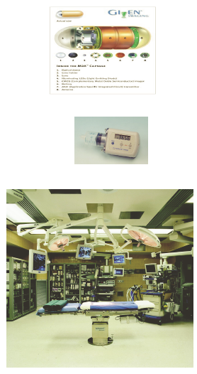
IoT Application Example (3)
Scenario: Health Care
Operating Room of the Future
  Closed loop monitoring and control; multiple treatment stations, plug and play devices; robotic microsurgery
  System coordination challenge

Slide 24
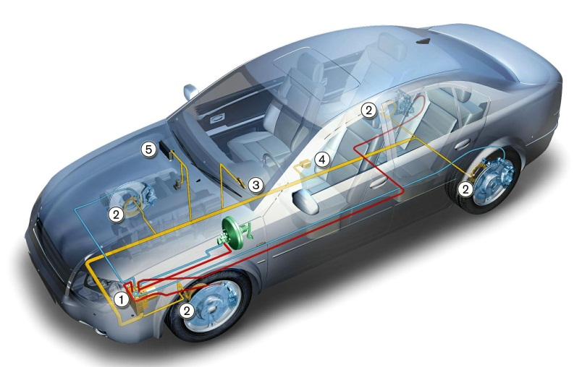
IoT Application Example (4)
Scenario: Transportation
A network of sensors set up throughout a vehicle can interact with its surroundings to provide valuable feedback on local roads, weather and traffic conditions to the car driver, enabling adaptive drive systems to respond accordingly
This may involve automatic activation of braking systems or speed control via fuel management systems. Condition and event detection sensors can activate systems to maintain driver and passenger comfort and safety through the use of airbags and seatbelt pre-tensioning
Sensors for fatigue and mood monitoring based on driving conditions, driver behaviour and facial indicators can interact
to ensure safe driving by activating warning systems
or directly controlling the vehicle

Slide 25
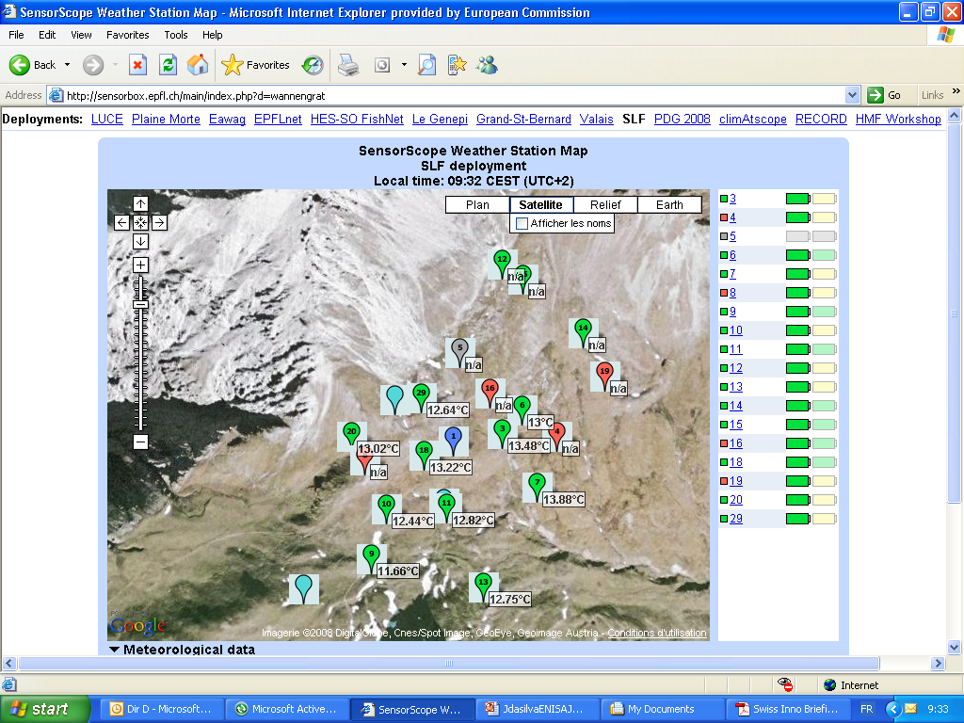
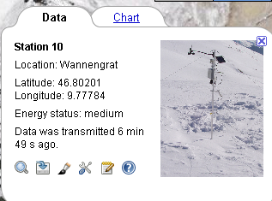
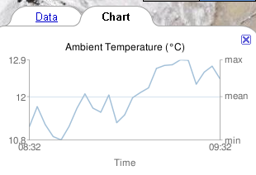
Scenario : Monitoring the Environment
IoT Application Example (5)

Slide 26
Tip
When describing a background of your research area it is useful to describe a specific examples of applications relevant to this area

Slide 27
IoT benefits
According to McKinsey, the financial impact of IoT on the global economy may be as much as $3.9 to $11.1 trillion by 2025
  especially in the manufacturing and health care industries.

Slide 28
IoT benefits - Non-financial factors
Consumer time saved
Improved health
Improved productivity
Increased efficiency
  IoT-enabled traffic management systems can reduce congestion
Reduce waste
  Reduced fuel consumption
  Optimised power distribution
  …

Slide 29
IoT benefits - drive down cost
Manufacturing
  Potential savings from improved machine utilization
Smart home
  IoT technologies help homeowners save significant amounts of energy through smart thermostats and lighting systems that adapt to usage patterns and preferences.
IoT home management systems
  can reduce maintenance costs by anticipating and addressing problems before they escalate
IoT traffic management
  Savings from reduced fuel consumption
…

Slide 30
IoT benefits - fuelling innovation
The influx of capital has driven innovation, leading to the creation of new businesses and services.
Increase of demand for smart solutions in various sectors.

Slide 31
IoT benefits - new market opportunities
IoT technologies have unlocked new markets in both homes and cities attracting significant investment from private and public sectors
  Smart Home Market
    Surge in demand for connected appliances, home security systems, and entertainment solutions.
    Rapid expansion of the smart home ecosystem.
  Smart City Sector
    A hub for investment in infrastructure monitoring, waste management, and public safety.
    Enhancing urban living through smart technology integration.

Slide 32
IoT benefits - job market and skills requirements
The growing IoT industry has created a demand for a range of new skills, leading to job creation in areas such as
  system design
  data analytics
  cybersecurity
While IoT may automate certain tasks, the human element remains critical, especially in areas requiring
  complex decision-making
  creative problem-solving
  strategic planning

Slide 33
IoT Challenges (1)
Scalability
  In 2015 there were 83 million smart devices in homes
  In urban environments, each of us is surrounded by 1000 to 5000 trackable objects
  IoT devices generate a large amount of data, creating data explosion.
  Endless applications are being developed that utilize substantial number devices, providing data-based services such as temperature, pressure, vibrations, and energy measurements.
  Scale of IoT applications varies, from small personal networks, through smart spaces and smart cities to all Earth connected into IoT.

Slide 34
IoT Challenges (2)
Interoperability
  Heterogeneity in computing systems will not disappear in the future, but instead will increase as the range of computing devices widens.
  In IoT environments heterogeneity is particularly high.
  Devices embedded in environments may use standard protocols as well as tailored made mechanisms
    software,
    hardware devices,
    network infrastructures

Slide 35
IoT Challenges (3)
Safety
  Many of the IoT applications are safety-critical, e.g. healthcare or elderly-care applications. They need highest reliability support that can be provided.
  Fault tolerance for device level solutions is more difficult than for environments with central entities generating global knowledge.
  The dynamic nature of the environment, resource-constraints of the participating devices, and the limited knowledge make it hard to design robust fault tolerant mechanisms

Slide 36
IoT Challenges (4)
Privacy
  How to convince users that the IoT technology will protect their data and privacy when tracking
Security
…

Slide 37
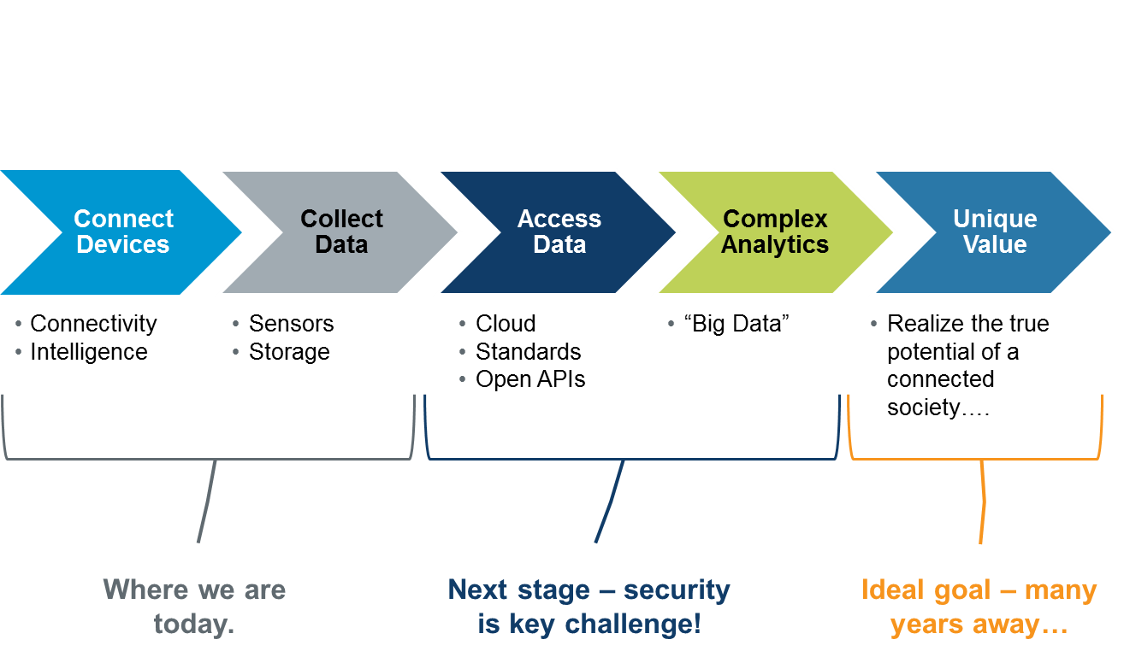
Evolution of IoT

Slide 38
IoT Research Fields
IoT architectures
IoT enabling technologies
IoT services
IoT economic value potential
…

Slide 39
IoT Architectures
Things-centric architectures
Data-centric architectures
Service-centric architectures
CPS platforms
Future Internet design for IoT
Cloud-based IoT
System security and manageability
…

Slide 40
IoT Enabling Technologies
Sensors
Radio frequency identification
Low power and energy harvesting
Sensor networks
Machine-type communication
Resource-constrained networks
Real-time systems
IoT data analytics
In situ processing
Embedded software
…

Slide 41
IoT Services
Applications, standards and test-beds
Streaming data management and mining platforms
Service middleware
Open service platform
Semantic service management
Security and privacy-preserving protocols
Design examples of smart services and applications
IoT application support
…

Slide 42
IoT economic value potential
IoT impact on economy
Calculating value from IoT
Policy recommendations
…

Slide 43
A researcher point of view…

Slide 44
IoT Journals Examples
IEEE Internet of Things Journal (launched in 2014), http://ieee-iotj.org
ACM Transactions on Internet of Things (launched in 2019), https://tiot.acm.org/ …..
(also journals relevant to specific research fields)

Slide 45
IoT Conferences Examples
IEEE World Forum on Internet of Things
ACM/IEEE International Conference on Internet of Things Design and Implementation
International Conference on Internet of Things
…..
(also conferences relevant to specific research fields)

Slide 46
Ways to search for research papers online
go to the University Town library website
go to a computer science bibliography website
go directly to the website of a journal you are interested in
use a browser of your choice
use a specialized academic/scholar browser
…

Slide 47
Summary
After this lecture you should
  Be familiar with background knowledge in IoT
  Know the branches and popular directions in IoT
  Know how to obtain the latest knowledge in this area

Slide 48
LASEC: Localized Approach to Service Composition
Joanna Izabela Siebert, Jiannong Cao, Steven Lai, Peng Guo, and Weiping Zhu, “LASEC: A Localized Approach to Service Composition in Pervasive Computing Environments,” IEEE Transactions on Parallel and Distributed Systems.
Notes:
48

Slide 49
UIO-based PvCEs
Pervasive Computing Environment
  A medium that provides user with all the functionality he needs to satisfy his requirements. It is built on physical world with embedded computing devices.
UIOs
  Smart objects augmented with various processing capabilities
  Mirrors can help with shopping
  Objects at home can serve as interfaces for controlling robots
  Drinking cup can monitor and remind about healthy drinking habits

Slide 50
Service Composition in PvCEs (1)
Service
  A functionality of a computational entity whose execution satisfies the requestor’s requirement.
Service Composition
  A process of identifying and combining component functionalities to compose a higher level functionality and provide means to perform the requested functionality.

Slide 51
Service Composition in PvCEs (2)
Characteristics of the UIO-based PvC environment
  Service requestors require services instantaneously to accomplish their goals
  Service requestors have no prior knowledge about the available services
  Service providers join and leave environments at run-time
  The demand of service requestors changes together with changes in context

Slide 52
Key Issues for Service Composition and in PvCEs
Bottom-up UIO collaboration support
  In UIO based PvCE, there is very large number of resource constrained UIOs and no guarantee of having a central entity capable of managing all other devices.
  To achieve desirable system behaviors, autonomous interaction of UIOs is required - enable to coordinate the UIOs and make them serve people in a less obtrusive manner.
Notes:
There are two key issues for …. The first issue is ………it may have…and also access contention is quite common. the other issue is………include…
52

Slide 53
Background
Existing approaches
  Centralized - as the service composition environment may be dynamic and large scale, centralized service composition algorithm is usually inefficient due to message cost.
  Decentralized with coordinators - a decentralized approach, which employs pre-determined coordinators to search and compose service, may have high cost as well, if the coordinators are far from those devices that should be composed.
Centralized
Hybrid
Decentralized

Slide 54
Motivation
Common feature - globalized nature of algorithms
  At least one node needs to maintain global information about the current task and about network status.
  Unsuitable for highly dynamic and large scale environments - huge communication overhead, especially with frequent changes of topology.
  Global knowledge is not always necessary, since in service composition for PvCE, it is beneficial when the distance between the services used in composition is as small as possible.
To remedy the problem of maintaining global information, we have opted to adopt a localized approach, which naturally tends to select compositions with high degree of composition locality.

Slide 55
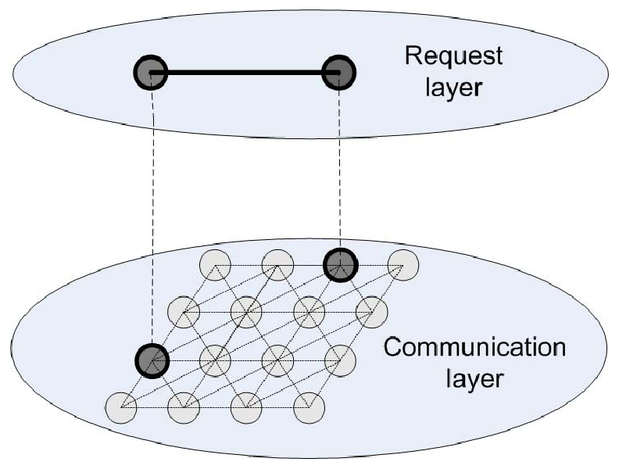
Problem Statement
Given
  A set of nodes each providing certain services, the nodes are interconnected and can communicate with each other via wireless network,
Assume
  A user specified requested composite service with specified types of requested services and relationships between them.
Objective
  Design a localized protocol for the nodes to collaborate in the composition process
Such that
  The communication cost is minimized.

Slide 56
Overview of the Solution (1)
Requirements for new solution
  There should be no special entity to manage service composition process
  Service providers can communicate only with their local neighbours, not all other service providers
  No service provider knows the full global information or gathers it
  Initially, service providers are atomic, in sense that they provide some functionality and are not coupled with any other service provider to provide a composed service

Slide 57
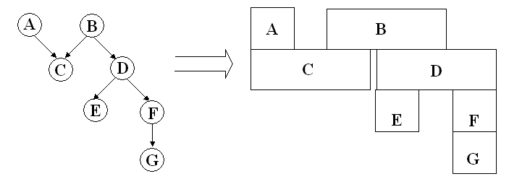
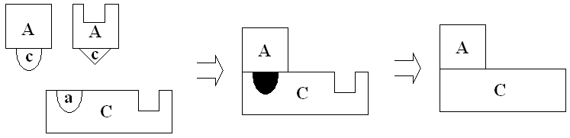
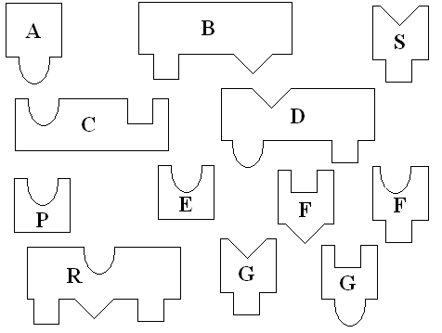
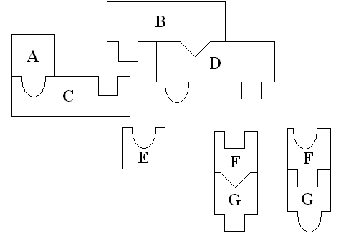
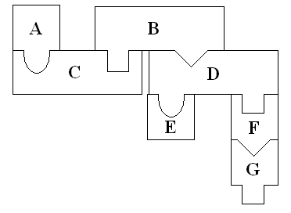
Overview of the Solution (2)
Inspired by the strategies adopted in solving jigsaw puzzles.
Forming service sections: Service provider identifies what service type it needs to interlock with through his output and then searches for appropriate service provider with matching input type.
Growing service: At later stages these sections are joined together with other sections to gradually construct the completed solution.

Slide 58
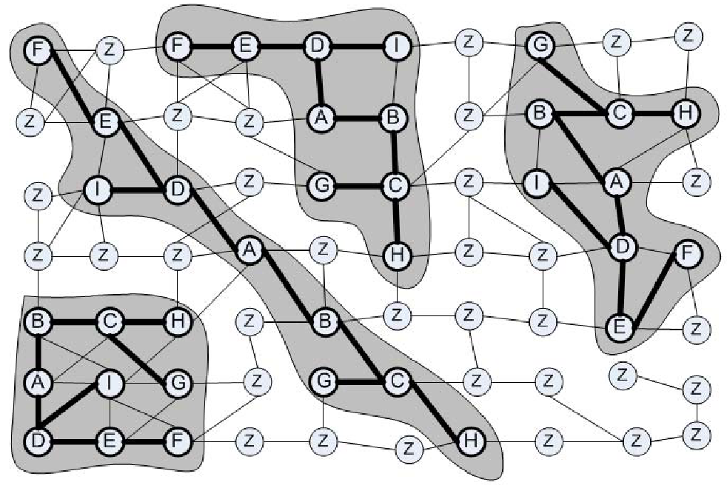
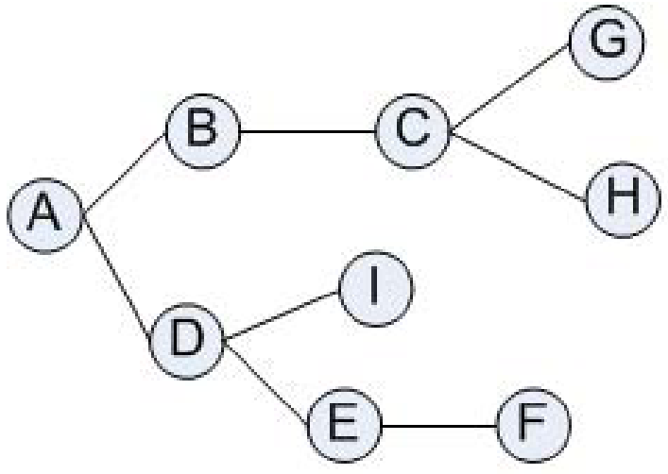
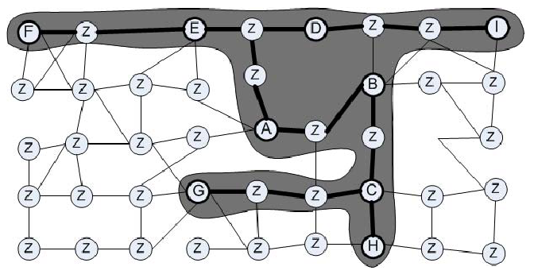
Overview of the Solution (3)

Slide 59
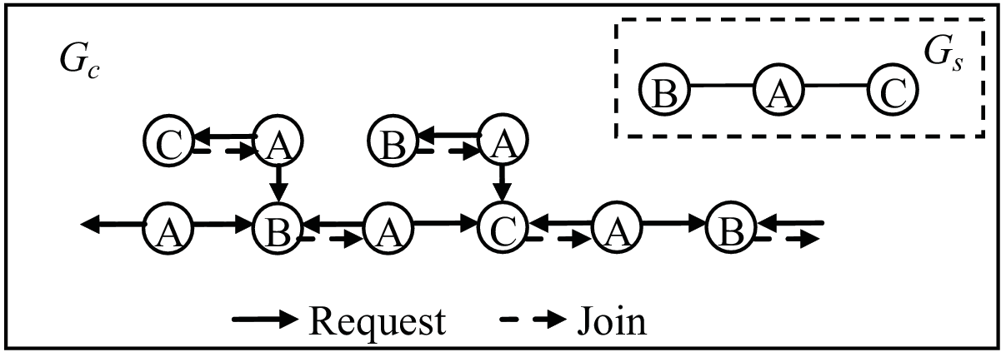
Challenging Issues
Awareness
  How does a node know the current members of the section that it has participated in? How does a node know the section that it has participated in has already failed?
Judgment
  How does a node know which section is more possible to succeed in the composition when the node is required to join? How to reduce or stop the useless composition which cannot be completed?
Assembly
  Since there is no coordinator in the network, how to guarantee the composition to converge into one integrated overlay graph.
How to constraint the blind and random composition among the UIOs that could not form the requested service so as to guarantee all the services specified in the request will be provided

Slide 60
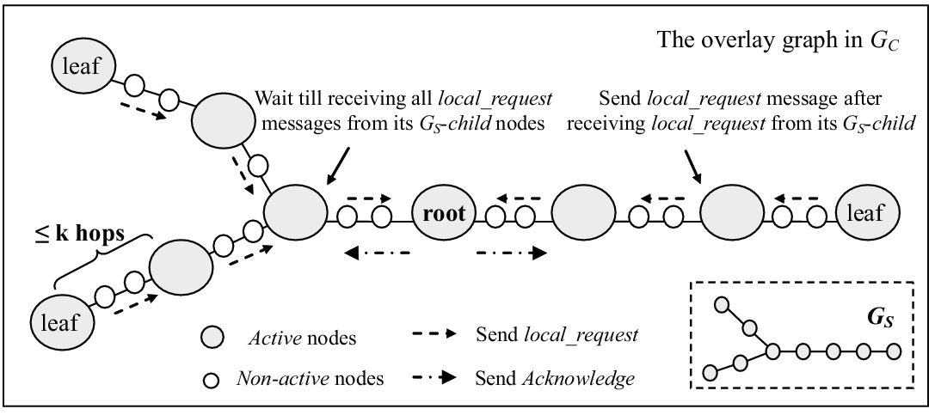
Basic Idea of LASEC
A-Ack mechanism
  UIO decide on collaborating with another UIO only after obtaining some additional information from the collaboration candidate.
  Specifically this information refers to ability of given UIO to compose another part of the service.

Slide 61
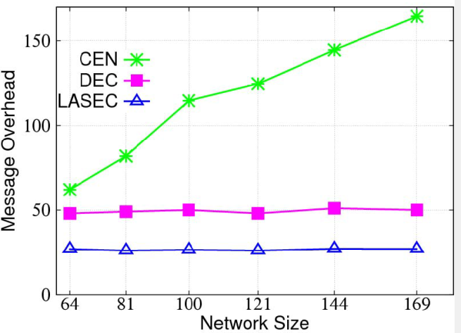
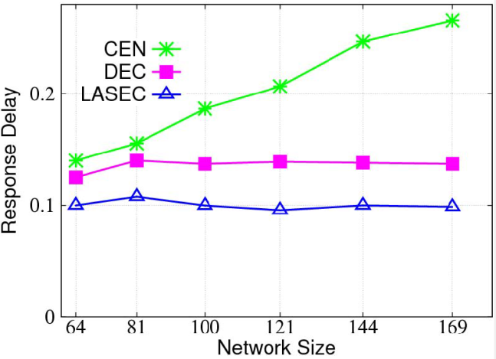
Simulation Results (1)
Scalability with regards to network size
  Message overhead
  Our LASEC service composition mechanisms require less messages than CEN for finding first result.
  LASEC scales very well with the growing size of the network while CEN imposes larger cost when the network grows.
  Response delay
  LASEC algorithm performs better than DEC and CEN.
  Similar as with message cost, LASEC and DEC scale better than CEN.

Slide 62
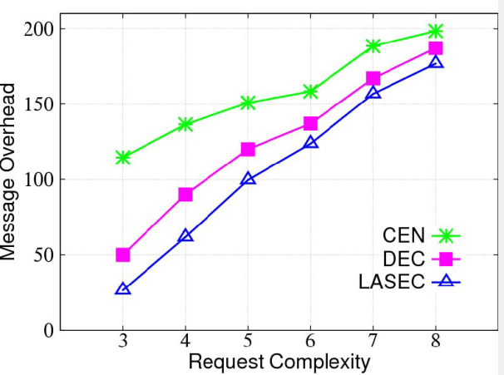
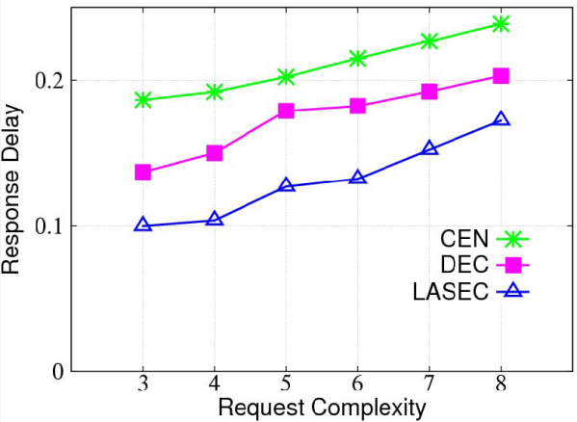
Simulation Results (2)
Scalability with regards to request complexity
Message overhead
  Number of messages increases with the complexity of the request.
  Along with the growth of request complexity, LASEC and DEC generate more messages, while CEN is more scalable.
Response delay
  Our LASEC service composition mechanism performs better than DEC and CEN for finding first result.
  Moreover, DEC, CEN and LASEC perform similar in terms of scalability.

Slide 63
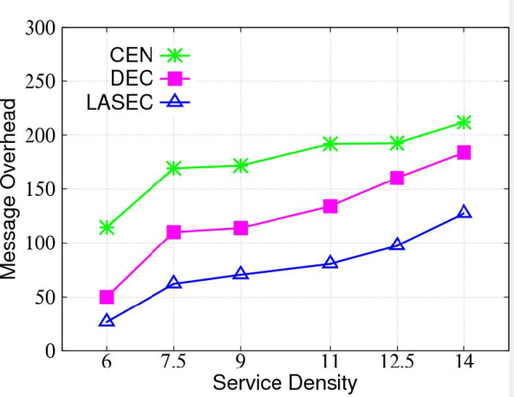
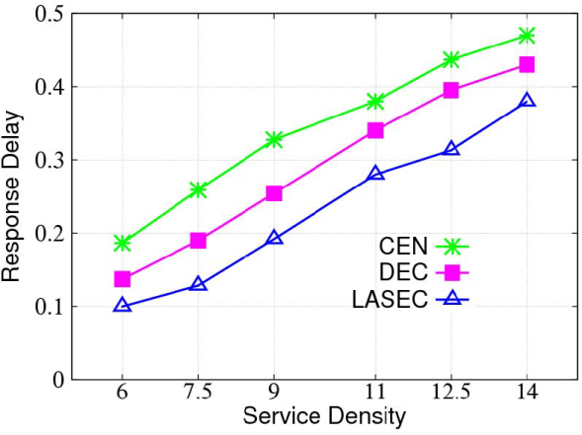
Simulation Results (3)
In these simulations we have explored localized characteristics of our approach and allowed nodes to forward message to 2 hop neighbours only.
We observe that response delay as well as number of messages increase with service density.
Our LASEC service composition mechanism has smaller overhead than DEC and CEN for finding the result

Slide 64
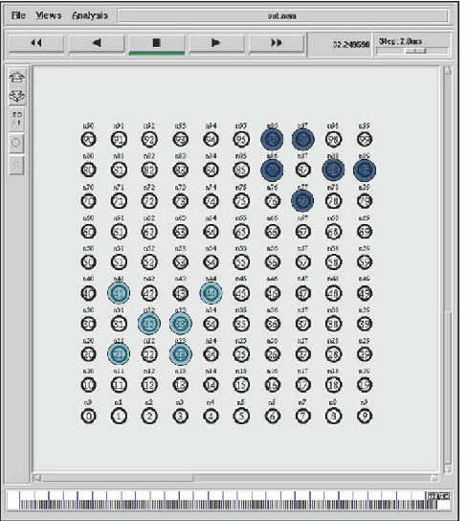
Simulation Results (4)
Composition locality - the distance between the services used in composition
LASEC tends to select compositions with high degree of composition locality

Slide 65
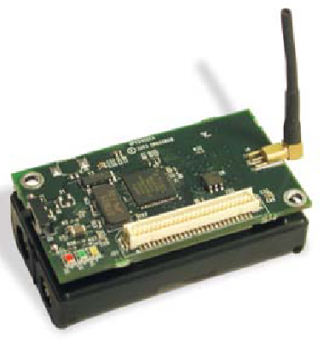
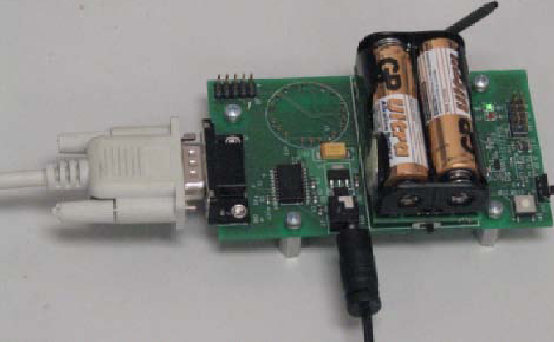
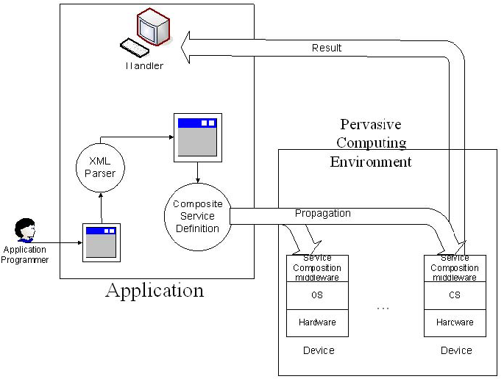
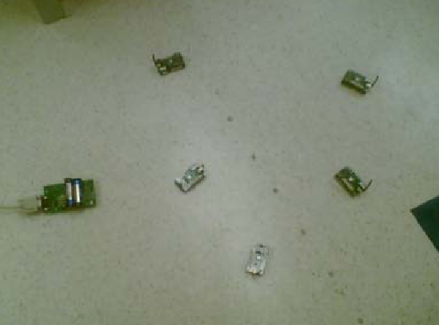
Experiment Results (1)
40 MicaZ nodes with a MIB600 gateway deployed in an indoor environment.

Slide 66
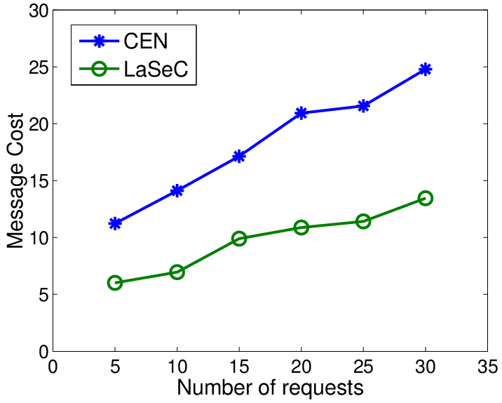
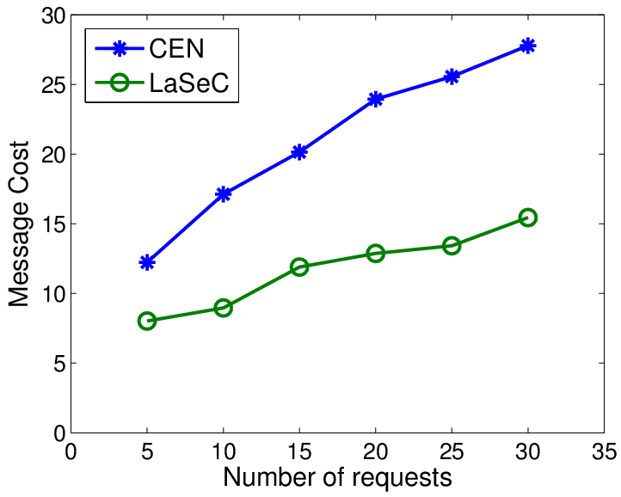
Experiment Results (2)
Message cost
  LASEC can reduce the message cost by over 50 percent
  LASEC scales better when the number of services increases
10
20

Slide 67
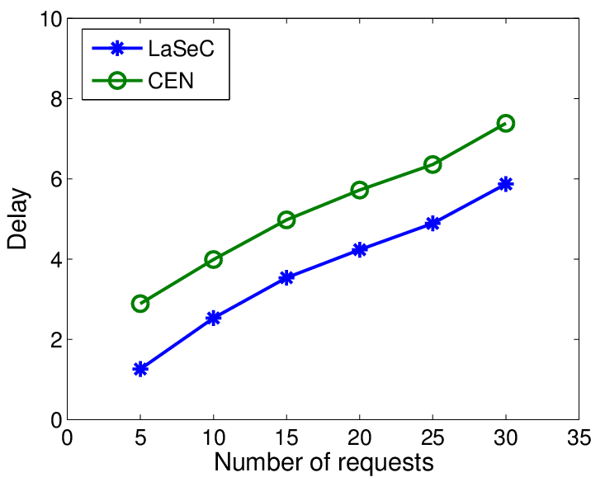
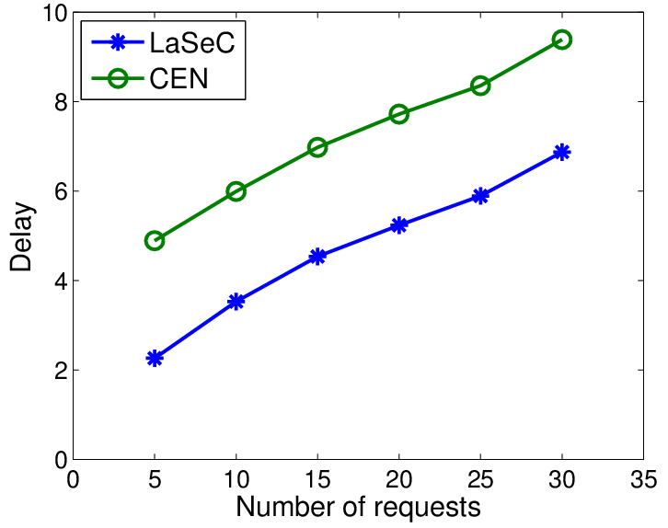
Experiment Results (3)
Message delay
  LASEC achieves smaller delay, especially when there are more services in the environment.
10
20

Slide 68
Conclusion
We investigated the characteristics of UIO based large scale and dynamic pervasive computing environments, and identified the new challenges caused by these characteristics in the design of service composition support.
We then study how to design localized service composition protocols in large scale dynamic environments.
  Scalable service composition
  Composed service reconfiguration
  Heterogeneity support
The bottom-up community is scalable enough to carry on with service composition operations not depending on the scale of the environments.

Slide 69
Future Work
Evaluation
  Test the proposed solution with larger networks
  Use real devices to compare results with the simulation
  Carry out further experimentation using multitude of UIOs
QoS support
  Different approaches to increasing QoS utilizing localized interactions
  Consider diverse parameters of quality and incorporate them into the service composition mechanism

